Slide 1
Problem Solving Test

Slide 2
Fuzzy Implications
Question 1
Suppose, P and T are two universes of discourses representing pressure and temperature, respectively as follows.
P = { 1,2,3,4} and T ={ 10, 15, 20, 25, 30, 35, 40, 45, 50 }
Let the linguistic variable High temperature and Low pressure are given as THIGH = {(20, 0.2),(25, 0.4),(30, 0.6),(35, 0.6),(40, 0.7),(45, 0.8),(50, 0.8)}
PLOW = (1, 0.8),(2, 0.8),(3, 0.6),(4, 0.4)
Then find the fuzzy implication If temperature is High then pressure is Low ?
Question 2
X = {a, b, c, d} Y = {1, 2, 3, 4}
Let, A = {(a, 0.0),(b, 0.8),(c, 0.6),(d, 1.0)}
B = {(1, 0.2),(2, 1.0),(3, 0.8),(4,0.0)}
Determine the implication relation : If x is A then y is B

Slide 3
Fuzzy Inferences
Apply the fuzzy GMP rule to deduce Rotation is quite slow Given that : If temperature is High then the rotation is Slow?
temperature is Very High?
Let, X = {30, 40, 50, 60, 70, 80, 90, 100} be the set of temperatures.
Y = {10, 20, 30, 40, 50, 60} be the set of rotations per minute.
The fuzzy set High(H), Very High (VH), Slow(S) and Quite Slow (QS) are given below. H = {(70, 1),(80, 1),(90, 0.3)} VH = {(90, 0.9),(100, 1)}
S = {(30, 0.8),(40, 1.0),(50, 0.6)} QS = {(10, 1),(20, 0.8)}
Defuzzification

Slide 4
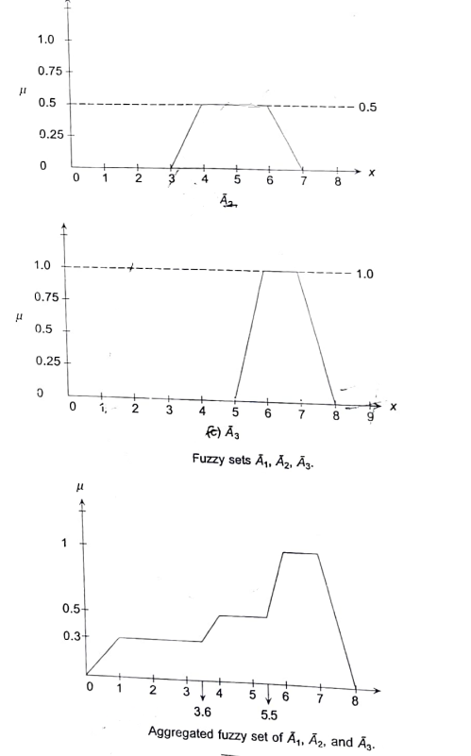
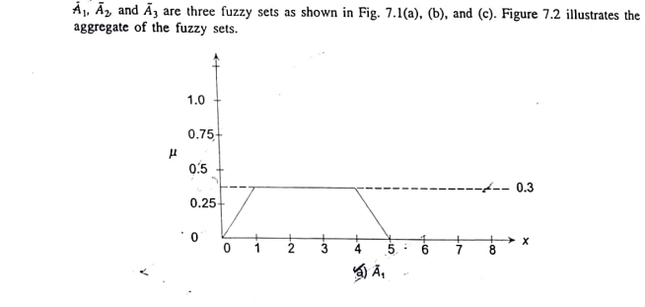
Defuzzification using Centroid method, center of Sum and Mean of Maxima method.

Slide 5
Implementations
Movie Recommendation with Python
Washing machine Problem with Python

